Slide 1
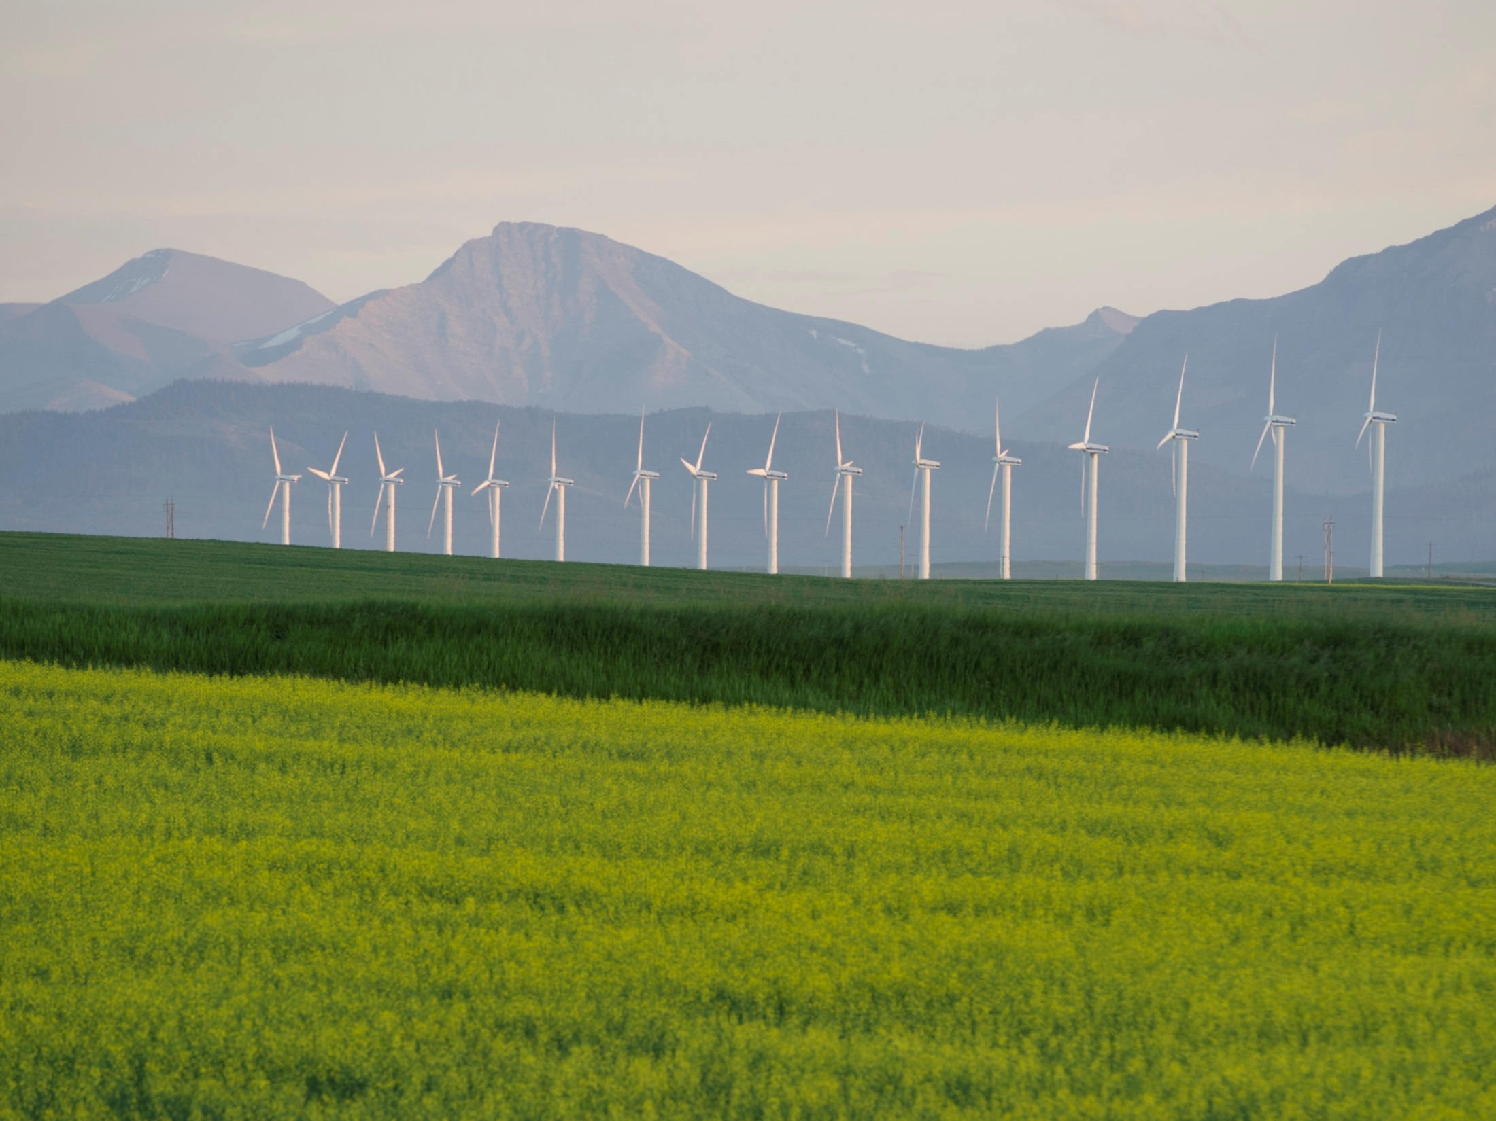
Alberta’s Climate Leadership Plan
New York Energy Forum
April 11, 2018

Slide 2
Alberta Economic Situation / Oil Production
In March 2018 Alberta's seasonally adjusted unemployment rate was 6.3% down from the 8.3% rate that was registered a year earlier
In 2017, Alberta had the fastest growth in Canada at 4.5%
Last year the Alberta economy created 90,000 new full time jobs with every sector of the economy expanding.
In 2017, Alberta’s production of crude oil and equivalent was about 3.4 million barrels per day (bbl/d). This represented an increase of about 10% from the 2016 production level of 3.1 million bbl/d.
The vast majority of Alberta’s crude oil leaves the province. In 2017, about 85% of total Alberta crude oil, or 3.25 million (bbl/d), was sent to the United States and to the rest of Canada.
Alberta, alone, supplies approximately 37% of U.S. oil imports.

Slide 3
Canada – U.S. Oil Pipeline Network

Slide 4
Alberta’s Climate Leadership Plan

Slide 5
Alberta Emissions Profile
274 Mt CO2e – total provincial GHG emissions in 2015
18 percent or 41 Mt – emissions growth since 2005
38 percent – Alberta’s percentage of Canada’s emissions in 2015

Slide 6
Reinvesting in our economy
Over the next 5 years, the levy is expected to raise $9.6 billion, all of which will be reinvested in the economy and rebated to Albertans.
$3.4 billion will help households, businesses and communities adjust:
$2.3 billion for carbon rebates to help low- and middle-income families
$865 million to pay for a cut in the small business tax rate from 3% to 2%
$195 million to assist coal communities, Indigenous communities and others with adjustment
$6.2 billion will help diversify our energy industry and support jobs:
$3.4 billion for large scale renewable energy, bioenergy and technology
$2.2 billion for green infrastructure like transit
$645 million for Energy Efficiency Alberta, a new provincial agency that will support energy efficiency programs and services for homes and businesses

Slide 7
Alberta’s Renewable Electricity Target 30 by ‘30
A target of 30 percent of electricity produced in Alberta will come from renewable sources such as wind, hydro and solar by 2030
To help achieve this 30 by ’30, the Government of Alberta will support 5,000 megawatts of additional renewable energy capacity for Albertans
Estimated that at least $10.5 billion in new investment will flow into the provincial economy by 2030
estimated 7,200 new jobs for Albertans as projects are built

Slide 8
Pay into the Fund
Carbon
Market
Reduction at
non-regulated
Facility (offset)
and/or
Purchase Offset and/or EPC
Bank or Sell EPC
Excess GHG
Emissions
Facility Emissions Limit*
Reduced GHG
Emissions (EPC)
Emitter A
Emitter B
* Facility Emissions limit = reduction requirement from historical performance baseline

Slide 9
Ongoing updates:
www.Alberta.ca/Climate
www.efficiencyalberta.ca

